Slide 2
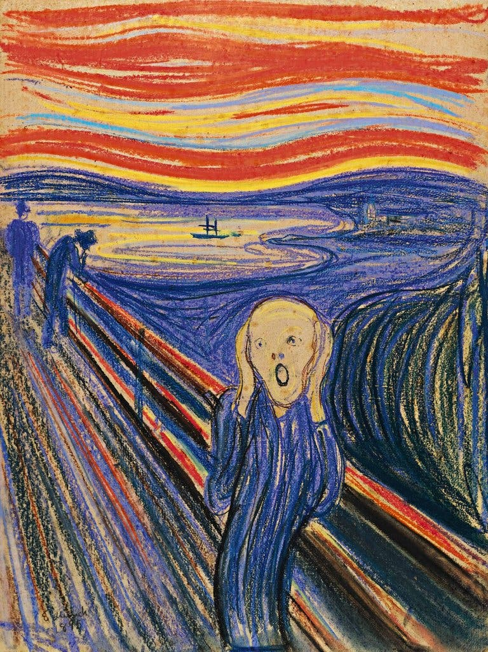
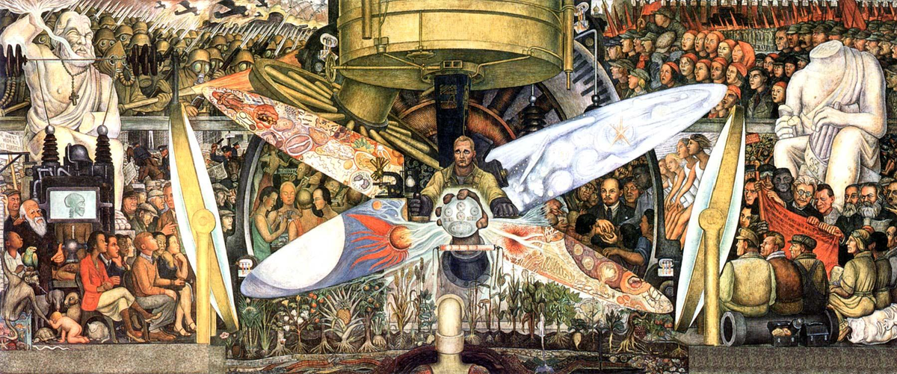
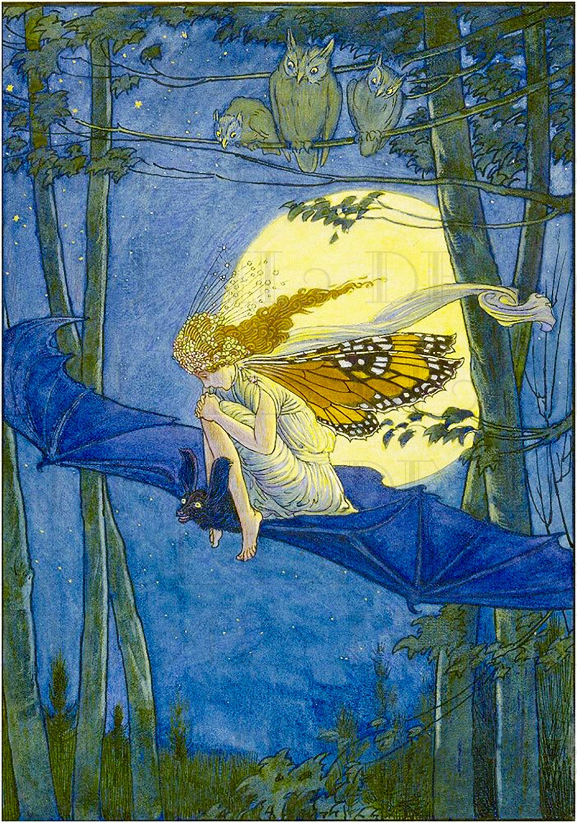
Why Visual Art Matters
A universal medium for expressing ideas, emotions, and cultures
Reflects creativity
The Scream
Captures the political and social climate of early 20th-century Mexico
A raw depiction of anxiety and existential dread.
Emotive brushwork and intense colors convey inner turmoil.

Slide 3
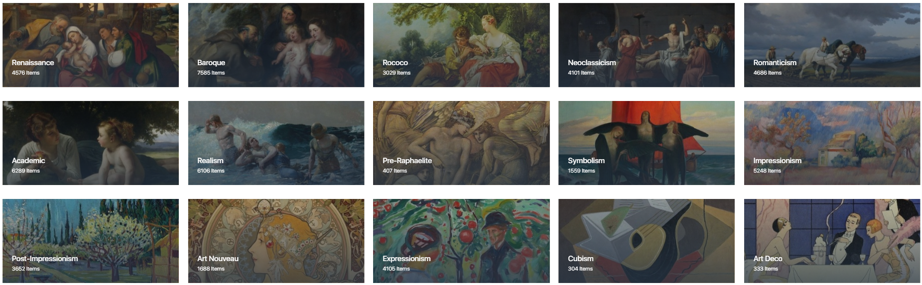
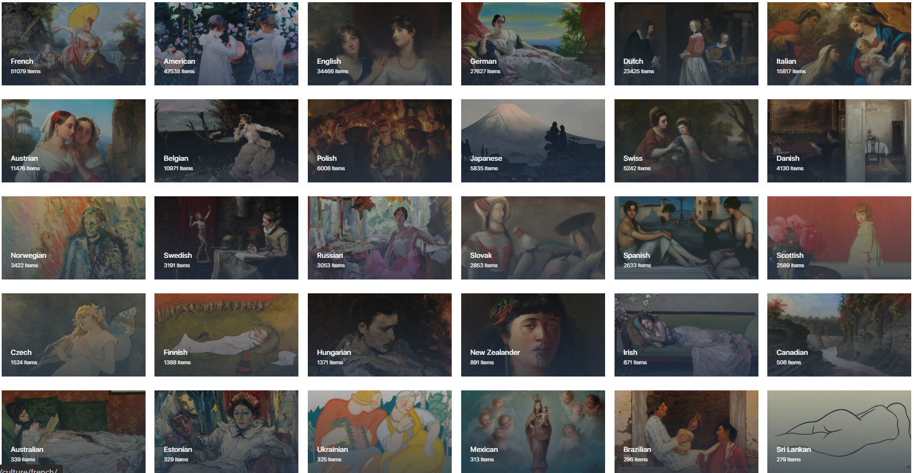
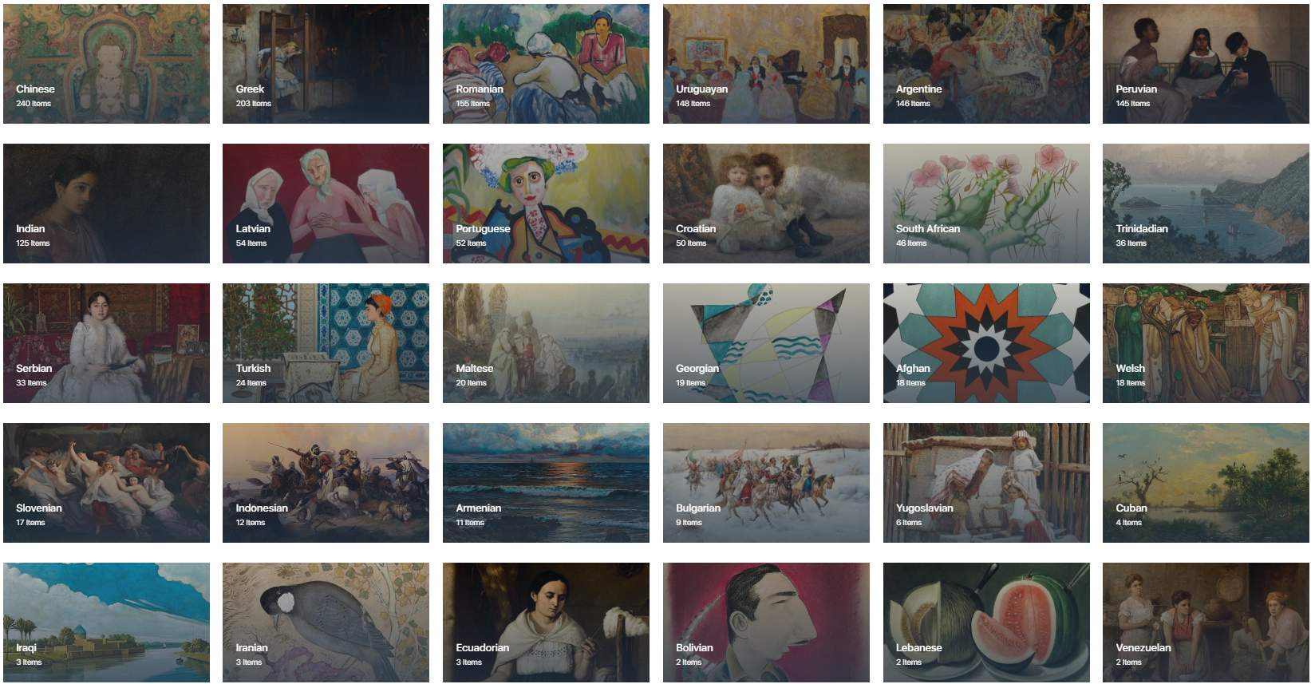
Movements and culture

Slide 4
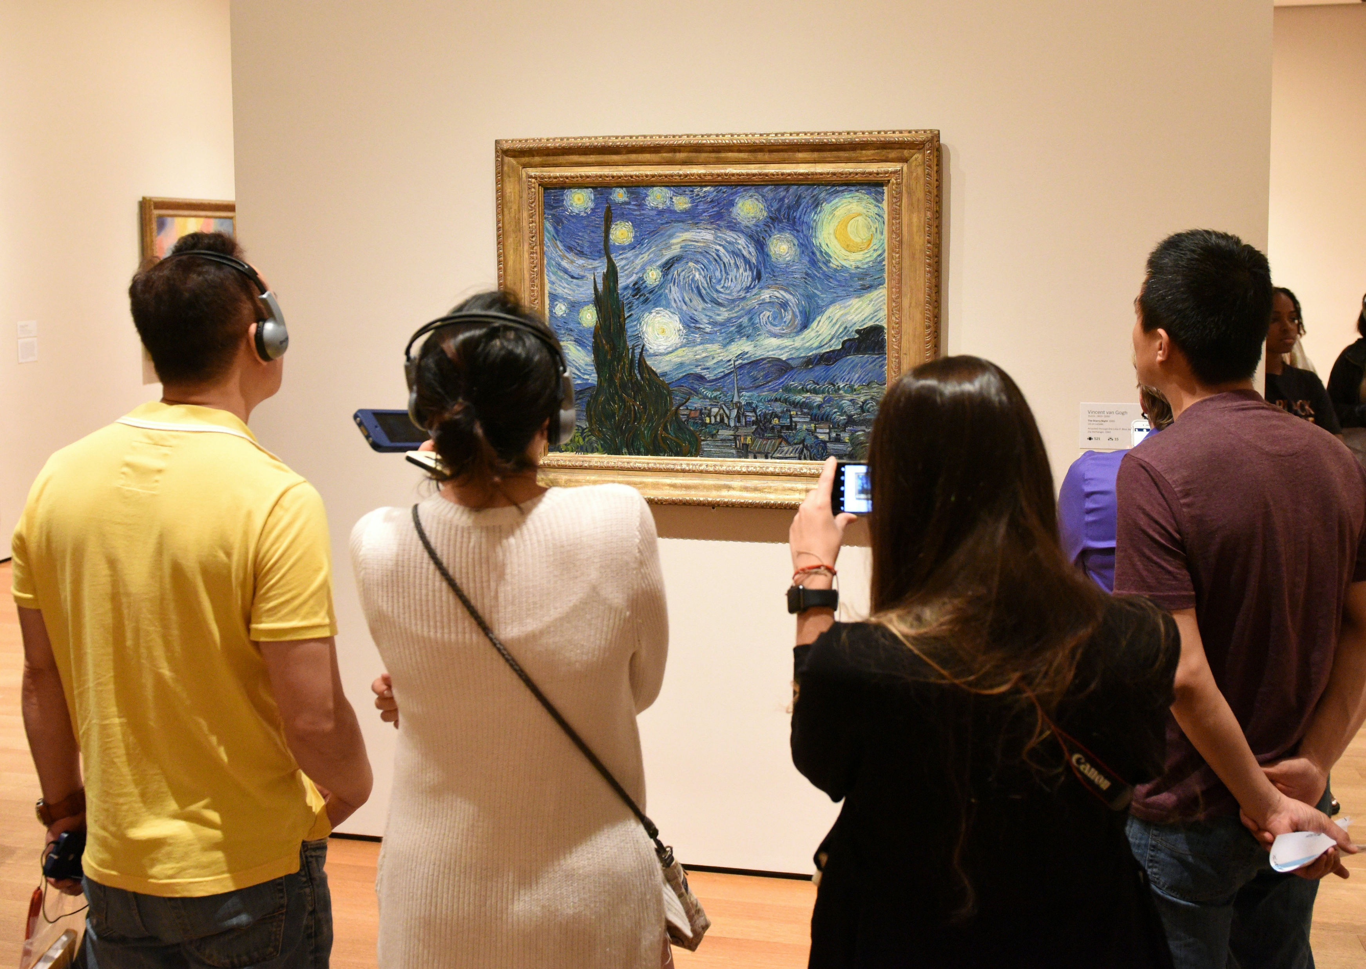

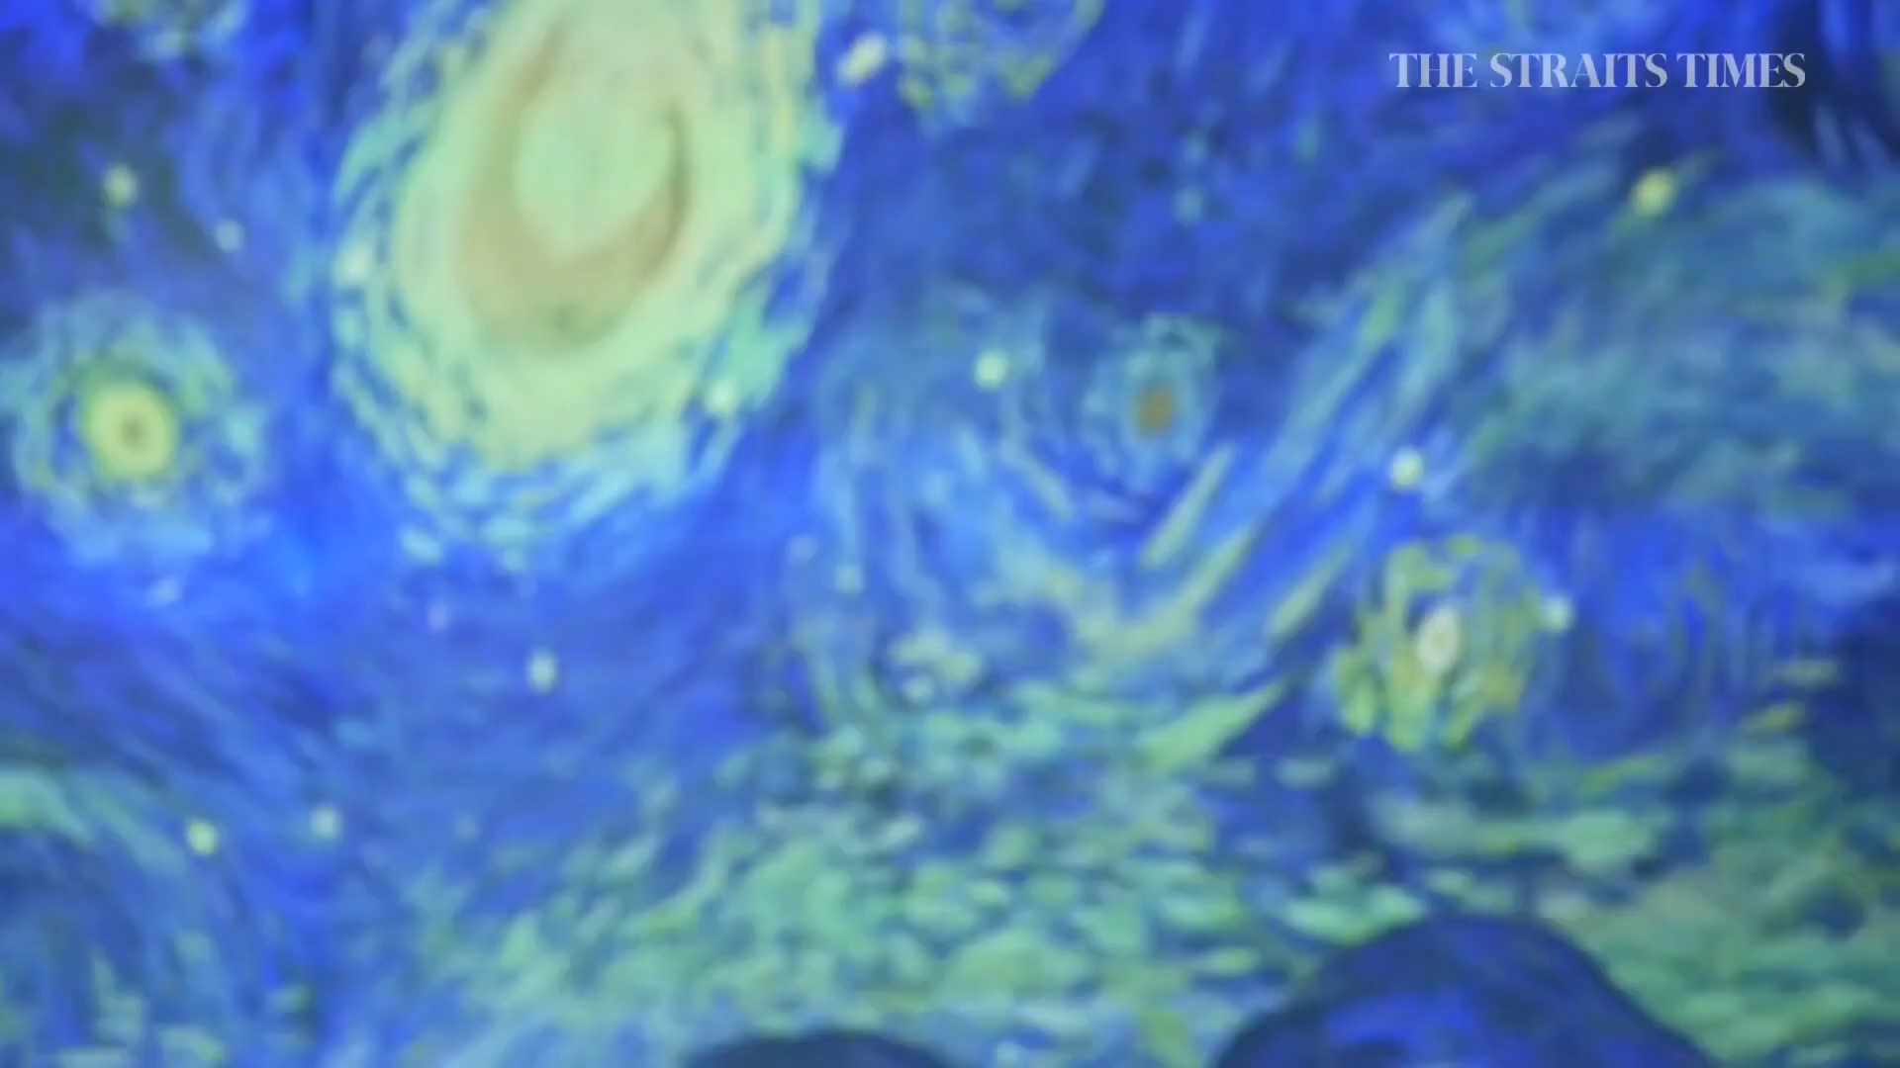
Physically restricted access
Limited interaction
Static digital image → animation
digital image - Accessible anytime, anywhere

Slide 5
Digital Art — New Possibilities

Slide 6
Watch Art Come to Life,
brushstrokes revealing a painting step-by-step
Digital Art
Image processing
Machine learning
Human computer interaction

